Slide 1
Automated ETL with Data Lake Storage
Abhishek Kanoujia
Data Engineering Batch-1

Slide 2
Introduction
Our project aims to automate the Extract, Transform, Load (ETL) process using Azure services. The process is divided into three main stages. Firstly, we'll perform ETL from blob Storage to ADLS, facilitating the efficient transfer of data between storage instances. Next, we'll focus on ensuring data quality and monitoring by leveraging Azure Databricks. Finally, we'll integrate continuous integration and continuous deployment (CI/CD) pipelines using Azure DevOps to manage ETL scripts effectively.

Slide 3
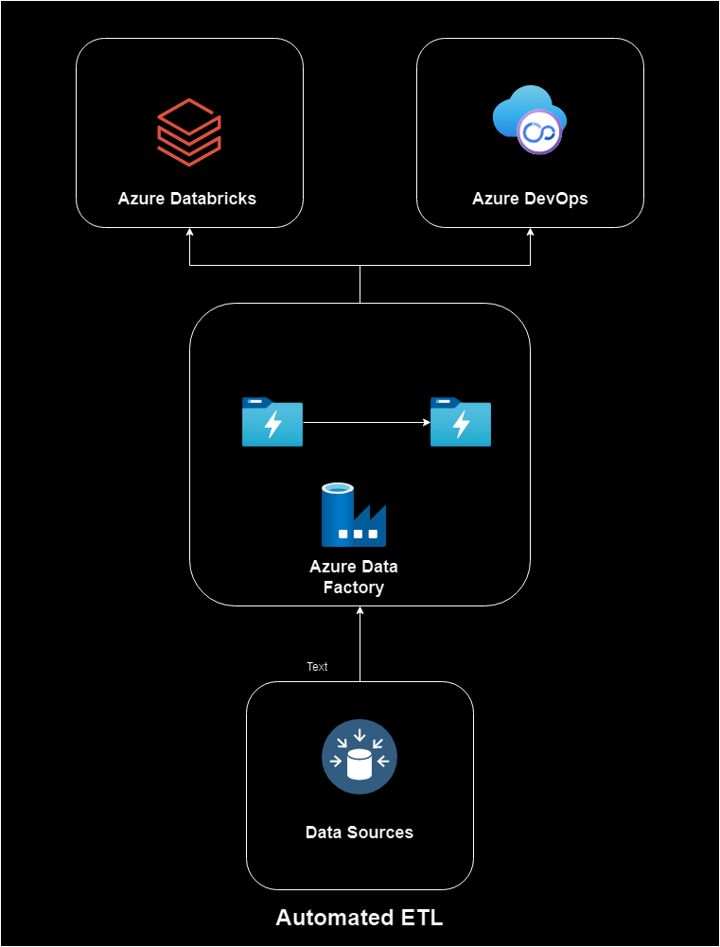
Architectural Diagram

Slide 4
Project Scope
Azure Data Factory (ADF): Used for data ingestion, Azure Data Factory allows us to efficiently collect data from various sources and move it to the desired destination. In this project, ADF is responsible for bringing in Olympics data from external sources
Azure Data Lake Storage Gen2: This is where the ingested data is stored. Azure Data Lake Storage Gen2 provides a scalable and secure platform for storing large volumes of data. It enables us to manage, access, and analyze data effectively.
Azure Databricks: For data transformation, we leverage Azure Databricks with PySpark. Databricks provides a collaborative environment for data engineers and data scientists to work together on big data projects. In our project, we use PySpark to clean, reshape, and process the raw Olympics data into a more usable format.

Slide 5
Technologies Used
Azure Data Lake Storage: Source and destination for ETL.
Azure Databricks: Data quality assurance, monitoring, and complex transformations.
Azure DevOps: CI/CD for version control and automated deployment.
Various data sources: (List the sources you'll be working with).

Slide 6
Implementation
ETL from blob to ADLS:
Data Quality Assurance and Monitoring with Databricks:
CI/CD Integration:

Slide 7
Conclusion
Our project focuses on enhancing data quality through Azure Databricks and streamlining data movement with Azure Data Factory. By implementing robust quality checks and efficient data transfer mechanisms, we're poised to improve decision-making, reduce latency, and ensure scalability in our data infrastructure. This initiative underscores our commitment to fostering a resilient and agile data ecosystem, driving actionable insights and innovation throughout our organization.

Slide 8
Queries

